Slide 1
Model Of Computation
Presented By, Guided by,
Patil Manasi Arunrao DR. Manisha Dhage
Patil Chaitanya Anil
Thakur Uma Devidas
Patil Bhavin Ratansing

Slide 2
Content:
Introduction to model of computation
Classification of model of computation
Sequential Models
Functional Models
Concurrent Models
Conclusion

Slide 3
Model Of Computation
In computer science, and more specifically in computability theory, a model of computation is a model which describes how an output of a mathematical function is computed given an input.

Slide 4
Classification of Model of Computation
Models of computation can be classified into three categories:
Sequential Models
Functional Models
Concurrent Models.
Model of computation
Sequential model
Functional Model
Concurrent Model

Slide 5
Sequential Models
Post machines
Register machines
Finite state machines
Pushdown automata
Turing machines

Slide 6
Finite state machines
M = {Q, ∑, δ, q0, F}
Example:
String staring with a and ending with b
a
b
q₀
a
q₁
b
q₀
q₂
b
a
q₃

Slide 7
Pushdown automata
0 | 0 | 1 | 1 | 1 | 1
M = (Q, ∑, S, δ, q₀, z₀, F)
0^{n} 1^{2n}, n>=0
0,z₀/0z₀
0,0/00
1, 0/0
z₀
q₀
q₁
q₂
1, 0/0
1, 0/ε
ε, z_{0/}z₀
q₃
q₃

Slide 8
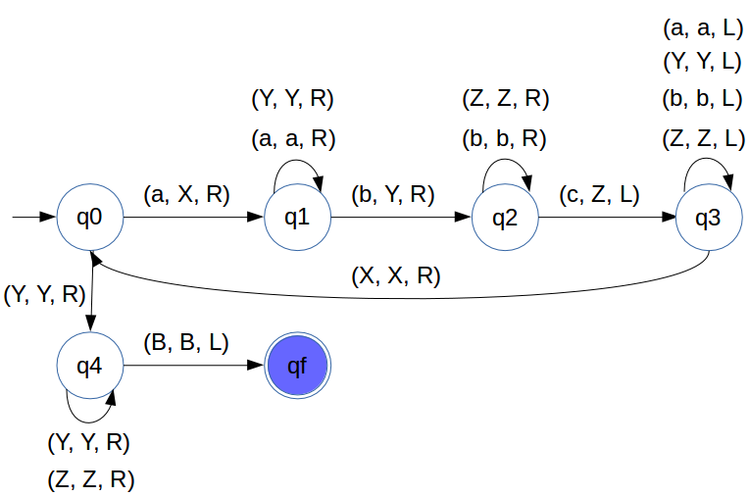
Turing machines
M = (Q, T, B, ∑, δ, q₀, F)
a^{n}b^{n}c^{n} , n>=1
B | B | a | a | a | b | b | b | c | c | c | B | B

Slide 9
Functional Models
Abstract rewriting systems
e.g. T = {a, b, c}
a → b, b → a, a → c, and b → c
Combinatory logic
General recursive functions
Lambda calculus

Slide 10
Concurrent Models
Actor model
Cellular automaton
Interaction nets
Kahn process networks
Logic gates and digital circuits
Petri nets
Synchronous Data Flow

Slide 11
Conclusion
A model of computation is a model which describes how an output of a mathematical function is computed given an input. A model describes how units of computations, memories, and communications are organized.

Slide 12



